Slide 1

Library OPAC with Mobile Renewal and Cloud based Notifications
PROJECT GUIDE : Mr. Dojohn Loyd, Asst. professor (O.G)
BATCH NUMBER : B16
TEAM MEMBERS : Ninad Jadhav (Reg no : 1030120018)
Jotish Suthar (Reg no : 1030120022)
SRM University
Department of Computer Science and Engineering
<number>/6

Slide 2
ABSTRACT
Books in college libraries have a barcode that is scanned each time a book is issued or renewed. This method uses a static scanner for performing the task.
We propose a real-time application based on android that makes use of smartphones to bring required mobility to the task of book renewal. A smartphone can use its camera to scan barcodes.
A barcode reader developed using ZXing library, scans barcodes of books and student IDs. The app, implementing REST architecture, sends a post request to a server for book renewal, using PHP. The PHP script then polls library’s database to fetch or update relevant data.
Cloud based notifications using GCM (Google Cloud Messenger) are used for generating remainders about renewing books.
SRM University
Department of Computer Science and Engineering
<number>/6

Slide 3
OBJECTIVES
To develop an application based on android that will enable library administrators to work dynamically as well as bring convenience to students.
To achieve essential mobility that is lacking in the task of book renewal and.
To enable the college to adopt a cloud based platform
SRM University
Department of Computer Science and Engineering
<number>/6

Slide 4
EXISTING SYSTEM
Current system used by the library comprises of a static scanner that is connected to oracle database via a VB based frontend.
It scans the barcode of books as well as student ID, to access relevant data so that books can be issued or renewed.
Drawbacks
Lack of mobility
Cumbersome for day scholars to carry heavy books to college
Unavailability of timely remainders
SRM University
Department of Computer Science and Engineering
Continued…

Slide 5
PROPOSED SYSTEM
A android based application that enables students to renew books using their smartphones.
Students will receive notifications pertaining to book renewals , remainders of next return/renewal date.
Advantages
Mobility , which is lacking in present system
Students won’t need to carry books all the time for renewal purpose as this task can be carried out from anywhere.
SRM University
Department of Computer Science and Engineering
5/6

Slide 6
SURVEYED RESOURCES
http://www.php.net/manual/en/function.oci-connect.php
http://blog.mingspc.com/2011/09/16/installing-php-with-oci8-enabled/
http://www.oracle.com/technetwork/database/features/instant-client/index-097480.html
http://docs.api.talis.com/platform-api/output-types/rdf-json
http://rest.elkstein.org/2008/02/what-is-rest.html
http://www.androidhive.info/2012/05/how-to-connect-android-with-php-mysql/
http://developer.android.com/google/gcm/index.html
http://www.php.net/manual/en/book.curl.php
SRM University
Department of Computer Science and Engineering
4/6

Slide 7
http://en.wikipedia.org/wiki/CURL
http://www.php.net/manual/en/curl.examples-basic.php
http://srmapi-hmm.rhcloud.com/magic.php
http://techlovejump.in/2013/11/android-push-notification-using-google-cloud-messaging-gcm-php-google-play-service-library/
http://tausiq.wordpress.com/2013/01/19/android-input-field-validation/
http://stackoverflow.com/
Using JSON for Data Exchanging in Web Service Applications Dunlu PENG, Lidong CAO, Wenjie XU, School of Optical-Electrical and Computer Engineering, University of Shanghai for Science and Technology, Shanghai 200093, China
SRM University Department of Computer Science and Engineering

Slide 8
REQUIREMENTS
System Requirements: As the project is a real time application, the requirements are based on the current system used by college library.
Operating System: Windows XP , Android OS(min 2.3)
RAM : 512Mb (Minimum)
Memory: 64 GB( Minimum)
Database: Oracle 9i, Oracle Instant Client(10gR2)
Server: Apache (WAMP)
Script: PHP
Tools: The development tools used are as follows:
IDE: Eclipse
Android SDK
Other Requirements:
GCM (Google Cloud messenger) will be used for generating the notifications.
Zxing Library
Server will require a static IP address
SRM University
Department of Computer Science and Engineering
6/6

Slide 9
SYSTEM ARCHITECTURE
The architecture explains the functioning of various modules and the interaction between them
The system architecture has been explained with the help of block diagram and flowcharts as follows
SRM University Department of Computer Science and Engineering

Slide 10
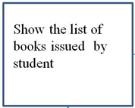

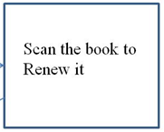
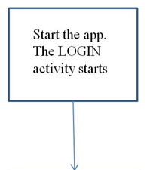

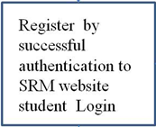
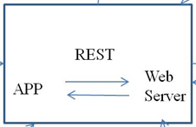

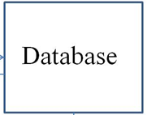




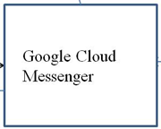

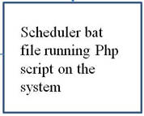
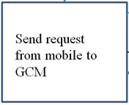
BLOCK DIAGRAM
<number>/9

Slide 11
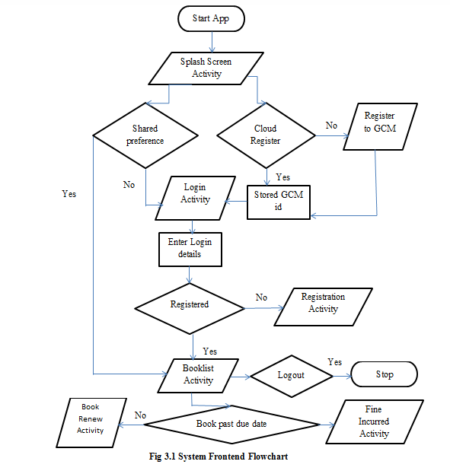
Android application frontend flowchart
SRM University Department of Computer Science and Engineering

Slide 12
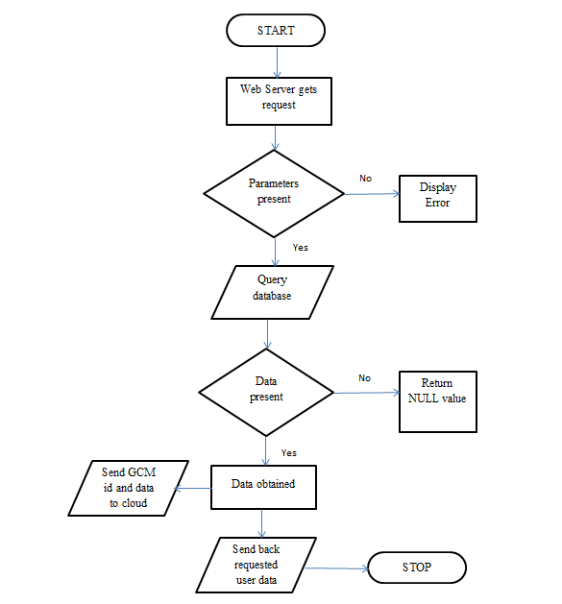
Android application backend flowchart
SRM University Department of Computer Science and Engineering

Slide 13
MODULES
Login & Registration Module : Authenticates student and registers them to the application
Book Renewal Module : Displays the books issued by user and enables users to renew them.
GCM Module : Sends notification to users
SRM University Department of Computer Science and Engineering
6/9

Slide 14



LOGIN & REGISTRATION MODULE
Send student credentials during registration
Authentication using CURL
Success code passed on correct credentials
Registration successful
SRM University
Department of Computer Science and Engineering
8/9

Slide 15
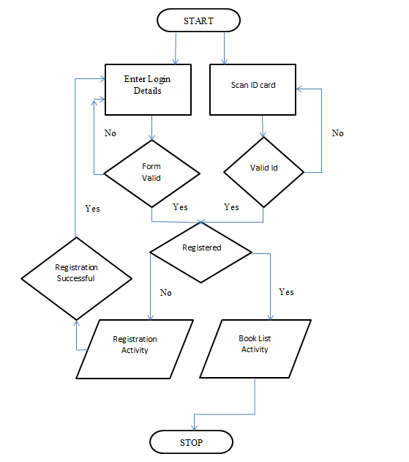
Login & Registration Module flowchart
SRM University
Department of Computer Science and Engineering

Slide 16
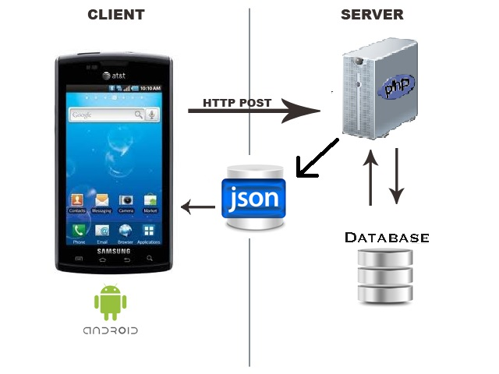
REST ARCHITECTURE
BOOK RENEWAL MODULE
Make HTTP Post request to server
Server queries the database fetching or updating data
The data and other response is encoded in Json format and sent to application
SRM University
Department of Computer Science and Engineering
6/9

Slide 17
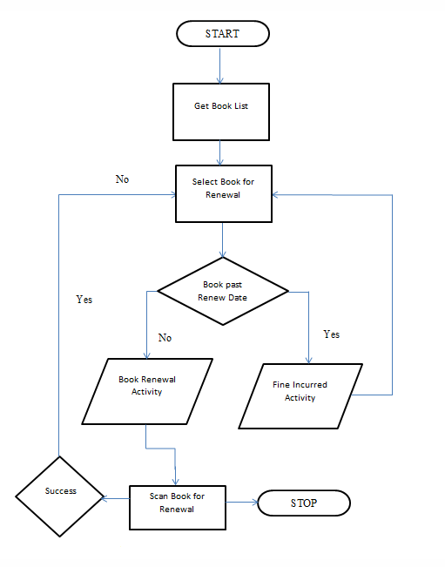
Book Renewal Module flowchart
SRM University Department of Computer Science and Engineering

Slide 18
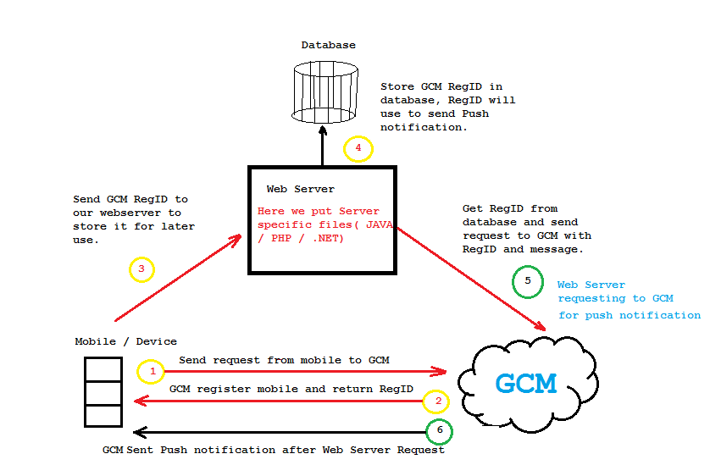
GCM MODULE
SRM University
Department of Computer Science and Engineering
7/9

Slide 19
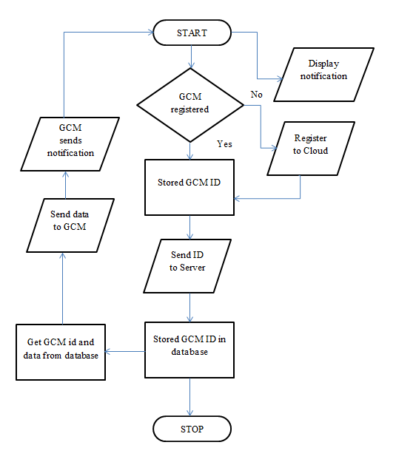
Google Cloud Messenger Module flowchart
SRM University Department of Computer Science and Engineering

Slide 20
ANDROID ACTIVITY
An android application has multiple activities that provide various options and interact with users. A module may contain multiple activities.
The activities for our project have been explained in detail as follows.
SRM University Department of Computer Science and Engineering

Slide 21
SPLASHSCREEN
The first activity that loads when application starts.
Enables checking the data stored in shared preferences
Registers the device to GCM in this duration
SRM University
Department of Computer Science and Engineering
<number>/20

Slide 22
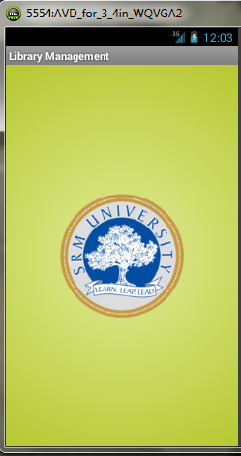
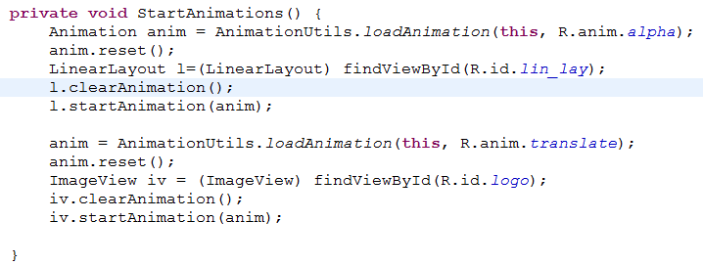
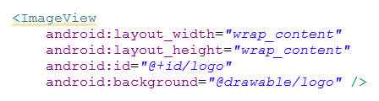
Function used for adding animation
Xml code
SRM University
Department of Computer Science and Engineering
<number>/20

Slide 23
LOGIN ACTIVITY
Performs Login for registered users using ‘Username-Password ‘ or direct ‘ID Scan’
Redirects to ‘Registration’ activity for new users
Performs validation
SRM University
Department of Computer Science and Engineering
<number>/20

Slide 24
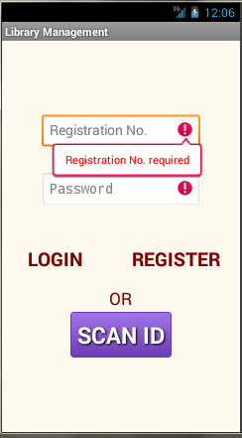
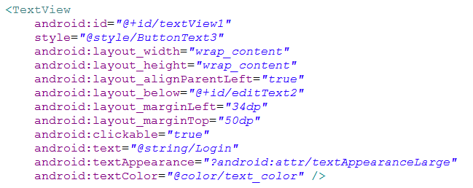
XML code for form widgets
SRM University
Department of Computer Science and Engineering
<number>/20

Slide 25
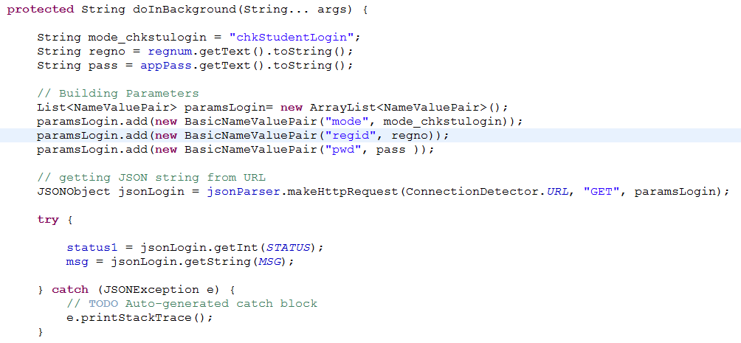
Backend process that checks credentials
SRM University
Department of Computer Science and Engineering
<number>/20

Slide 26
REGISTRATION ACTIVITY
Authenticates users using SRM student login web portal
Checks if students have applied to library
Registers authenticate users
Performs form validation
SRM University
Department of Computer Science and Engineering
<number>/20

Slide 27
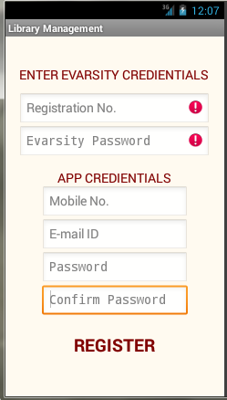
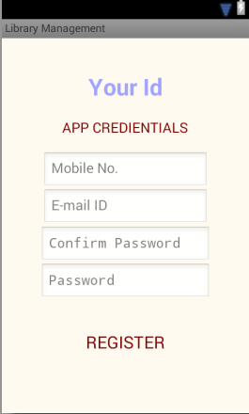
SRM University
Department of Computer Science and Engineering
<number>/20

Slide 28
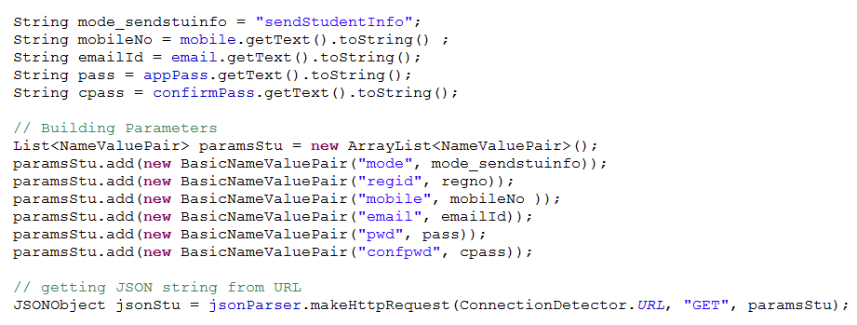
Registering authenticated students
SRM University
Department of Computer Science and Engineering
<number>/20

Slide 29
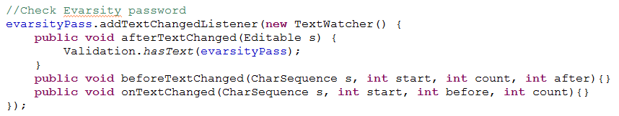
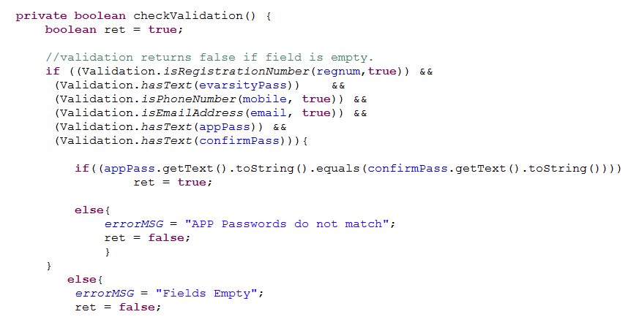
FORM VALIDATION
SRM University
Department of Computer Science and Engineering
<number>/20

Slide 30
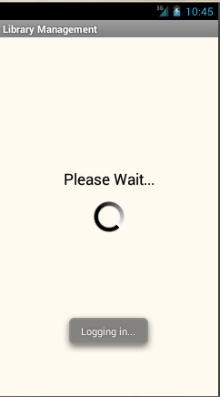
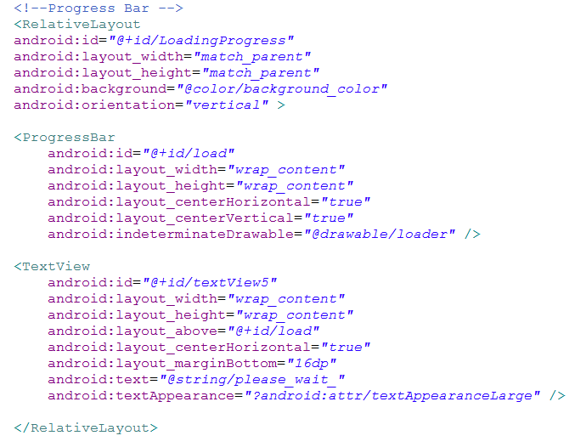
CUSTOM PROGRESS BAR
SRM University
Department of Computer Science and Engineering
<number> / 20

Slide 31
BOOK LIST ACTIVITY
Displays the list of books issued by the student, in a list format.
Each item in the list starts the renewal activity for the corresponding book.
Displays the book name and renewal date
‘Logout’ button that enables user to exit the session
Fetches current date , which is used to check if a book is past its due date or not
SRM University
Department of Computer Science and Engineering
<number>/20

Slide 32
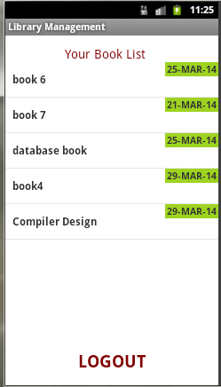
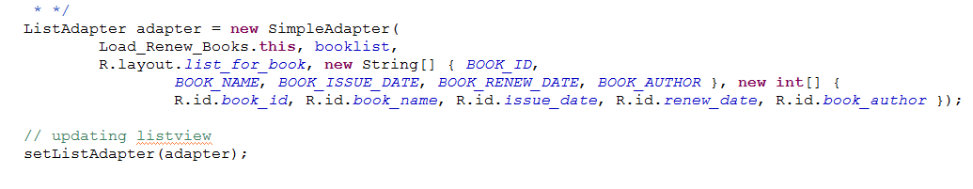
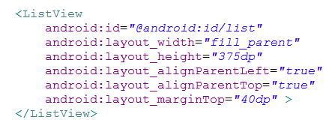
List adapter that maps data to xml layout
XML for list view
SRM University
Department of Computer Science and Engineering
<number>/20

Slide 33
BOOK RENEWAL ACTIVITY
Enables students to renew book by scanning the book barcode
Displays book information, the issue and return date for student
SRM University
Department of Computer Science and Engineering
<number>/20

Slide 34
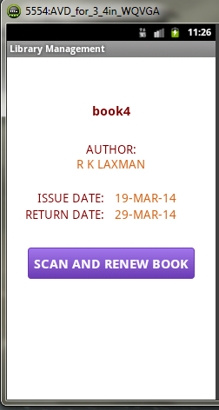
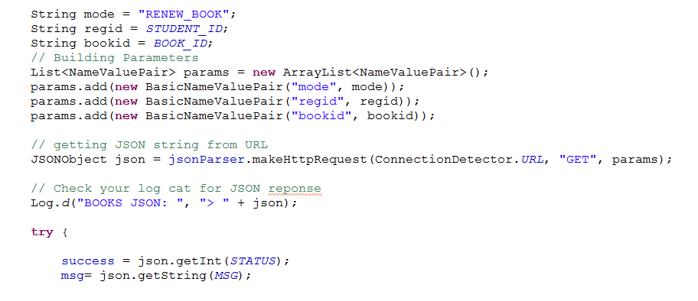
Sending data for book renewal
SRM University
Department of Computer Science and Engineering
<number>/20

Slide 35
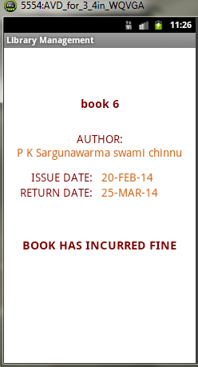
If a student tries to renew a book past its due date then this activity starts
SRM University
Department of Computer Science and Engineering
<number>/20

Slide 36
SUPPORT CLASSES
Validation – contains functions for performing validation of input fields
SessionManagement – for creating shared preferences
JSONparser – parsing json data
ConnectionDetector- checking internet connection
SRM University
Department of Computer Science and Engineering
<number>/20

Slide 37
BACKEND
Config.php – contains the configuration functions for connecting and accessing to oracle database
Backend.php - contains the different ‘modes ‘ used by application
SRM University
Department of Computer Science and Engineering
<number>/20

Slide 38
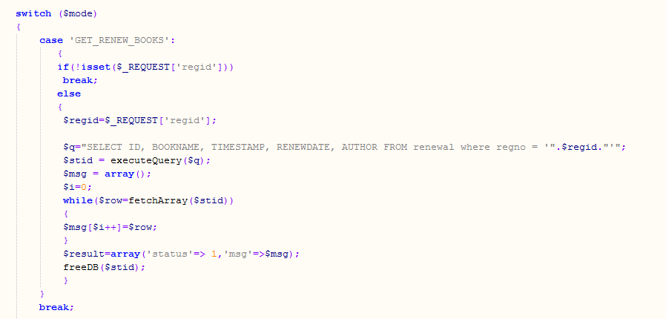
Backend sample code
SRM University
Department of Computer Science and Engineering
<number> / 20

Slide 39
CONCLUSION AND FUTURE WORK
SRM University students can conveniently renew their books without much hassle using this app. The library administrators will also be benefited, as long queues of students wanting to renew their books, will become scarce. The application will provide advantageous to college as it will encourage similar kind of initiatives in near future.
This developed app can be upgraded further by introducing more features.
Facility can be added for searching available books. Another feature that can be integrated is that students can access other user’s profile to view the list of books issued by them. Students can recommend good books to other users.
A book recommender can be added as well. It will recommend the list for books for each subject based the year in which the student is currently in. All in all, this is much scope for upgrading the current developed application.
SRM University Department of Computer Science and Engineering

Slide 40
THANK YOU
SRM University Department of Computer Science and Engineering
<number> / 20

